Slide 1
Module 3 Topic 2 Hydrogen & fuel cells

Slide 2
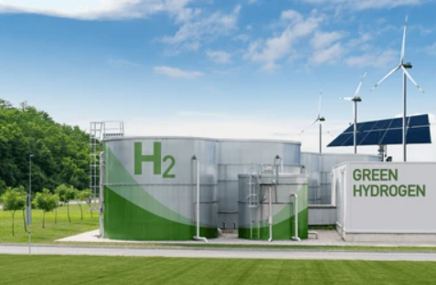
SOLAR- HYDROGEN FACILITY

Slide 3
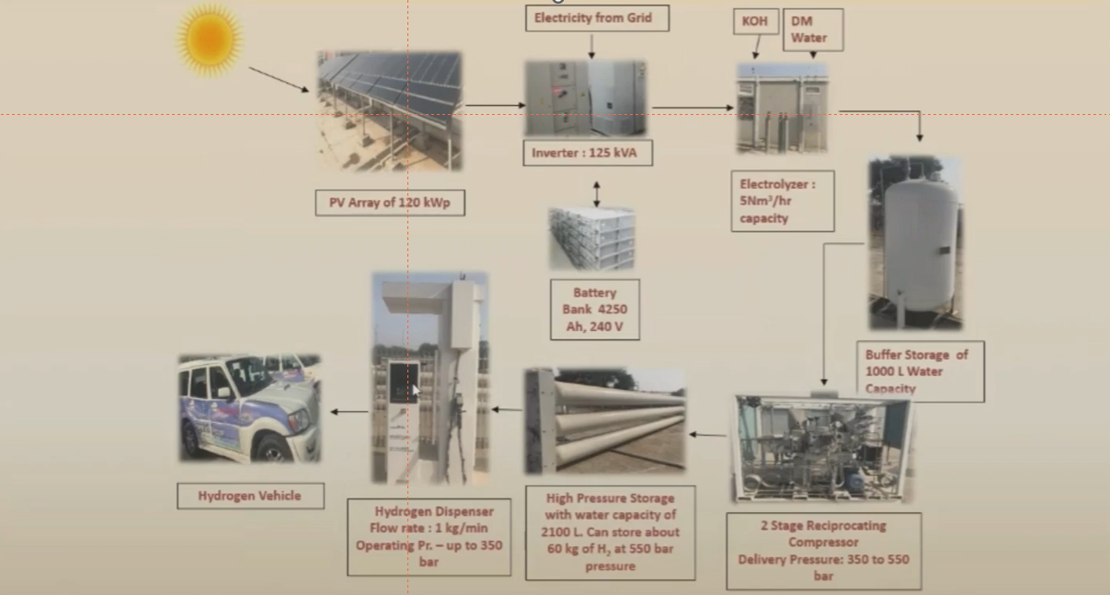
SOLAR HYDROGEN PRODUCTION CUM DISPENSING FACILITY

Slide 4
FUEL CELLS TYPES AND DIFFERENT APPLICATIONS

Slide 5
HYDROGEN & FUEL CELLS
Hydrogen energy storage systems use two separate processes for producing electricity using stored hydrogen
Electrolyser is a common way to produce hydrogen by splitting water and can be stored in high pressure containers
Stored hydrogen can be used for electricity generation, using the fuel cell
Fuel cells can convert chemical energy in hydrogen (or
hydrogen-rich fuel) and oxygen (from air) to electricity
Heat energy and water are also produced during the process

Slide 6
It is also possible to use an engine-generator set
Electricity generated by fuel cells is quieter, produces negligible pollution and is more efficient than the fossil fuel combustion approach
Fuel cell systems combined with hydrogen production and storage can provide stationary and transportation power

Slide 7
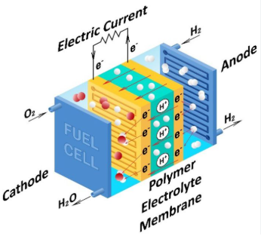
FUEL CELLS
Fuel Cells are electricity generating devices, like a turbine-generator in a
power plant, with a difference that fuel cells do not burn their fuel to
produce energy and have no moving parts.
Uses any hydrogen-rich fuel and air to produce electricity, heat and water
through electrochemical reactions.
Extremely versatile technology (ranging from W to MW scale)

Slide 8
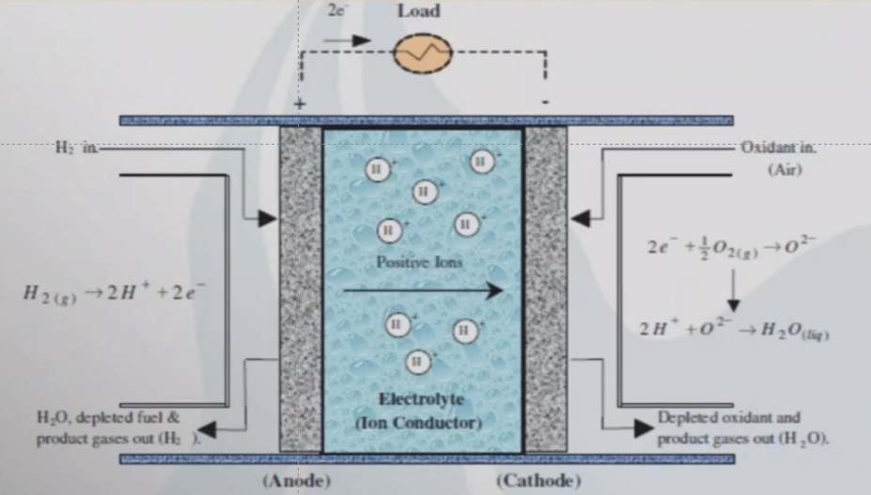

Slide 9
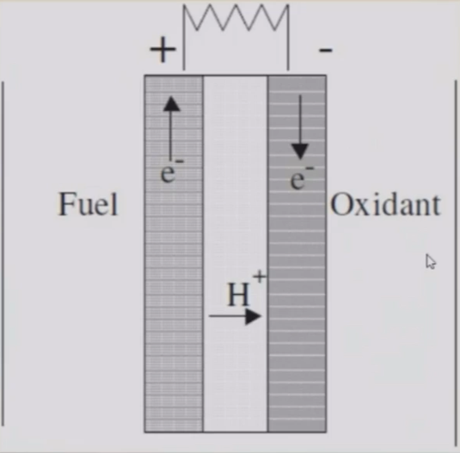
MEMBRANE ASSEMBLY OF FC ELECTRODE
• Fuel Product H+ +
e-
• Oxidant + H+ e- Product

Slide 10
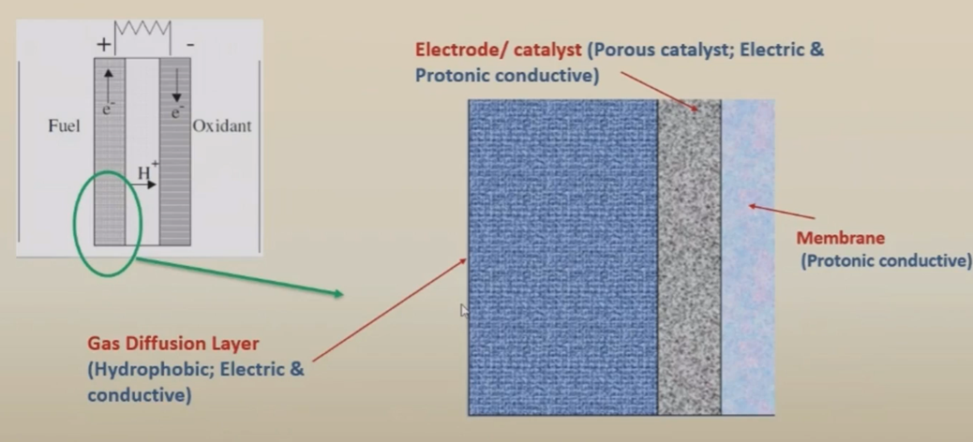
ELECTRODE & DIFFUSION LAYER

Slide 11
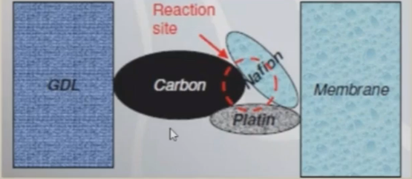
CATALYST LAYER
• Carbon (electrical
conductivity)
• Nafion (protonic conductivity)
• Reaction catalytic material
(e.g. Pt, Ru)

Slide 12
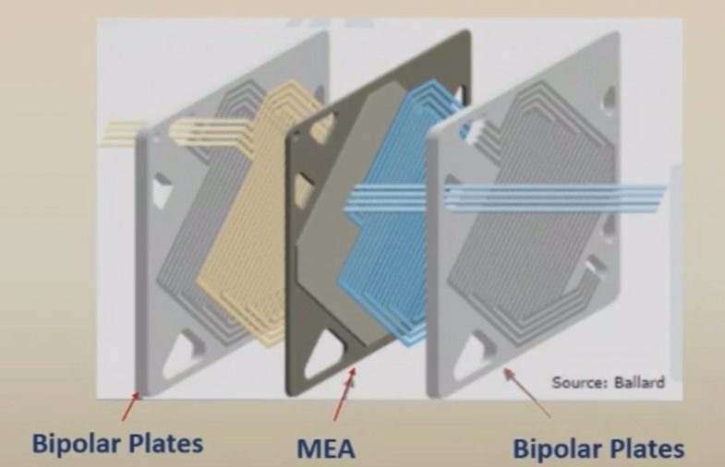
SINGLE CELL SCHEMATIC

Slide 13
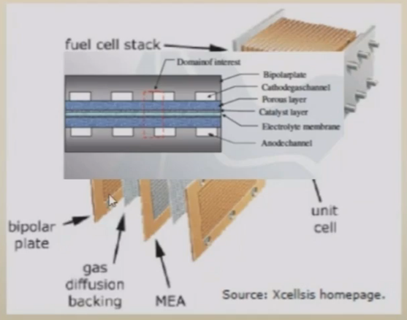
FC STACKS

Slide 14
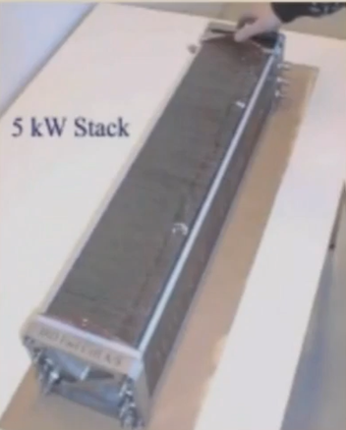
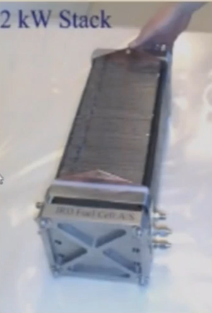

Slide 15
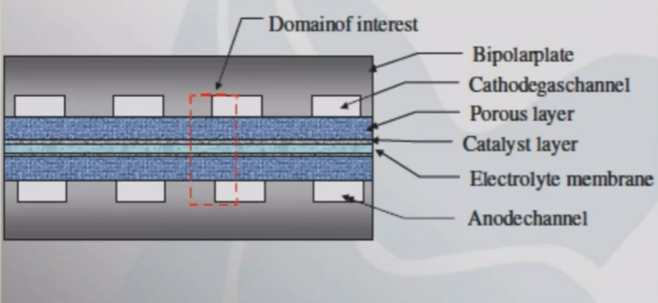
TOPOLOGY

Slide 16
Thank you

